Slide 1
An Introduction to Event-Related Potential (ERP) and functional Magnetic Resonance Imaging (fMRI) research
January 23, 2017
PSY 380: Neuroscience of Language
Dr. Susan C. Bobb
Notes:
Image source: https://www.ucl.ac.uk/brain-sciences

Slide 2
Agenda
How does EEG function?
What are ERPs?
What are the main differences between ERPs and fMRI? What questions are each best poised to answer?

Slide 3
Event-related potential – electrical potentials associated with specific events (also called “evoked potentials” because they are brain potentials evoked by stimuli)

Slide 4
Knowing where vs. knowing when
Brain localization = explains the where, locating the activity in the specific brain structure e.g., hippocampus, motor cortex etc.
This is also called functional neuroanatomy
But does this explain how something happens?
Cognitive mechanisms are the mental processes by which we process information that we see, hear, read, notice, remember, make decisions to acquire new knowledge
Notes:
Cf. discussion in Luck, p. 3
Other advantages: low cost (it can cost upward of 1M for the system and $500 per session in the scanner; an EEG system costs around 25,000 to buy, and maybe $10 in materials per testing session).

Slide 5
The Basics of Electrical Activity in Neurons
https://www.youtube.com/watch?v=c5cab4hgmoE
https://www.youtube.com/watch?v=W2hHt_PXe5o
Notes:
Start video at about 1:30
Neural Networks
Duration of an action potential is only about 1 millisecond. Postsynaptic potentials last 10 or hundreds of milliseconds. Confined to the dendrites and cell body (don’t travel down axon at fixed rate). So these postsynaptic potentials tend to summate and can be recorded at a greater distance (so the scalp). Cf. Luck p. 29
Single cell recordings possible.
Can do large populations of neurons for action potentials = multi-unit recordings
Postsynaptic potentials = local field potential recordings

Slide 6
Notes:
Action Potential vs. Slow Postsynaptic Potential
https://courses.washington.edu/conj/neuron/postsynaptic.htm
Duration of an action potential is only about 1 millisecond. Postsynaptic potentials last 10 or hundreds of milliseconds. Confined to the dendrites and cell body (don’t travel down axon at fixed rate). So these postsynaptic potentials tend to summate and can be recorded at a greater distance (so the scapl). Cf. Luck p. 29
Single cell recordings possible.
Can do large populations of neurons for action potentials = multi-unit recordings
Postsynaptic potentials = local field potential recordings

Slide 7
EEG Hardware
Notes:
Neural brain cells communicate via electric impulses, and the collective impulse generated by a group of neurons in the cerebral cortex can then be measured at the scalp‘s surface with the help of electrodes placed on the scalp.
A variety of sizes – 16, 32, and 64 channel systems are common, but more are required if you want to do serious source localization. Also Geodesic Nets that use a saline solution rather than gel.

Slide 8
Notes:
Since the actual impulse that is transmitted is very small (between 5 to 10 μV), the signal must first be amplified. Just as a comparison, a AA alkaline battery has around 1.5 volts, so the signal is really very small. The recorded, amplified brain activity is called EEG (electroencephalograpy)

Slide 9
Continuous EEG
Notes:
http://www.brainsinternational.com/index.cfm/what-is1/what-are-eeg-and-qeeg/
ERPs are derived from continuous EEG that are recorded from the scalp, and we do this by timelocking the EEG to an event that we are interested in.

Slide 10
Notes:
http://www.neuralsync.org/neuralsync-introduction-brainwaves/

Slide 11
Artifacts: Unwanted Noise in the Signal
Notes:
Other sources: 60 hz electrical noise (e.g., cell phone, computer screen), Alpha waves (fatigue/boredom), eyemovements

Slide 12
Averaged ERPs
Notes:
The signal of these data is then averaged over many trials to produce the event-related potential or ERP. The averaging technique allows random variation in neural activity which is unrelated to the appearance of the stimuli to be filtered out, leaving only electrophysical activity related to the stimuli. The peaks of the resulting waveforms, also called components, have been related to specific cognitive processes and can be used to provide insight into the processing mechanisms of the brain.
The awakened functioning EEG is comprised of ongoing rhythms, like theta, alpha and beta, intermixed with the brain’s responses to specific stimuli. These specific responses to stimuli are very small, commonly less than 10 microvolts, and these miniscule voltages are embedded in the ongoing EEG which may be 50-150 microvolts commonly.
This makes these smaller signals almost impossible to detect, but if an averaging technique is used, these small signals can be added together so they get larger and can be seen, but the EEG when added together randomizes out, so the smaller specific response signals emerge from the background EEG.
When these averaged signals are then processed, the brain’s response to these sensory stimuli and the brain’s processing of the information can be evaluated.
One shortcoming of the EEG is its spatial resolution. Another is that it records surface activity only. LORETA uses an inverse-solution to determine subcortical activity based upon the surface-recorded EEG. In essence, by estimating current density sources, it extrapolates the underlying activity, giving us a view of the more deep structures of the brain. Known as the “poor man’s fMRI,” due to it’s high correlation to fMRI studies, it is the first inexpensive, non-invasive assessment tool for practitioners of neuromodulatory approaches.
http://www.brainsinternational.com/index.cfm/what-is1/what-are-eeg-and-qeeg/

Slide 13
Putting it all together
Notes:
http://www.ncbi.nlm.nih.gov/pmc/articles/PMC3816929/

Slide 14
N400
Notes:
ERP is the summed voltage at an electrical site compared to a reference electrode.
Voltage = electrical potential “for charges to move from one place to another”
ERP = difference between the active and the reference electrode site
Negative simply means that the voltage at that site is less than that of the reference site.

Slide 15
Wednesday’s Agenda
The inverse problem
Finish talking about ERP advantages
fMRI
Know the difference between them

Slide 16
An example of an ERP study
https://www.youtube.com/watch?v=N5ZUDFZHKcc
Notes:
Turn to somebody: could you figure out what they were studying? What were they trying to determine?
Explain how they might have done this e.g., the N400 (which will be presented in more detail next class)
I ate the corn.
I ate the hat.

Slide 17
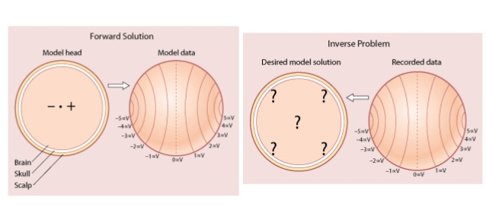
Strengths and Weaknesses: EEG
The good: temporal resolution (i.e., timing)
Inexpensive ($30,000 for the system, $10 per testing session)
The bad: spatial resolution (i.e., where in the brain things are happening)
The inverse problem
Notes:
“we cannot definitively localize the neural generators of ERP effects within the head from the data recorded outside of it. Thus, the outstanding temporal resolution of ERPs comes with the cost of living with an unknown degree to spatial resolution.” – Woodman (2010) http://www.ncbi.nlm.nih.gov/pmc/articles/PMC3816929/
Other advantages: low cost (it can cost upward of 1M for the system and $500 per session in the scanner; an EEG system costs around 25,000 to buy, and maybe $10 in materials per testing session).
Image: http://www.slideshare.net/dominic54/week-3-lecture-notes

Slide 18
The Inverse Problem
Results to Cause
Notes:
Term is actually widely used in science to denote any process by which we take a set of observations and try to calculate their origin
Remember from last class that I told you what we measure with EEG is the postsynaptic potentials of a group of neurons, with this activity projected to the scalp surface. What we are asking in the Inverse Problem is ”Who generated that activity?” In other words, where did the activity come from?
Turn to somebody and explain what the inverse problem is

Slide 19
Can it be solved?
Cognitive Experiments, such as those about language, usually involve lots of brain areas. Makes the neural generators difficult to predict
Direction of current affected by conductivity of the brain skull, extracranial tissue etc.
But if you knew the direction/orientation of the ERP sources/dipoles, you could now accurately predict where the activity is coming from.
If you need to know “where”, just use imaging instead!
Notes:
http://www.cogsci.mq.edu.au/facilities/erp/documents/presentations/an%20introduction%20to%20spatial%20analyses.pdf
http://events.rice.edu/index.cfm?EventRecord=674
http://web.mit.edu/~ppurdon/www/source-imaging.pdf
https://books.google.com/books?id=_2bneq9tl9sC&pg=PA542&lpg=PA542&dq=inverse+problem+in+ERP&source=bl&ots=A-0LzdPO0R&sig=HEFZcOY-LOAn9dSulBnHDfwarAg&hl=en&sa=X&ved=0ahUKEwiloOq0mdzRAhVrK8AKHWXSC_04ChDoAQgsMAM#v=onepage&q=inverse%20problem%20in%20ERP&f=false

Slide 20
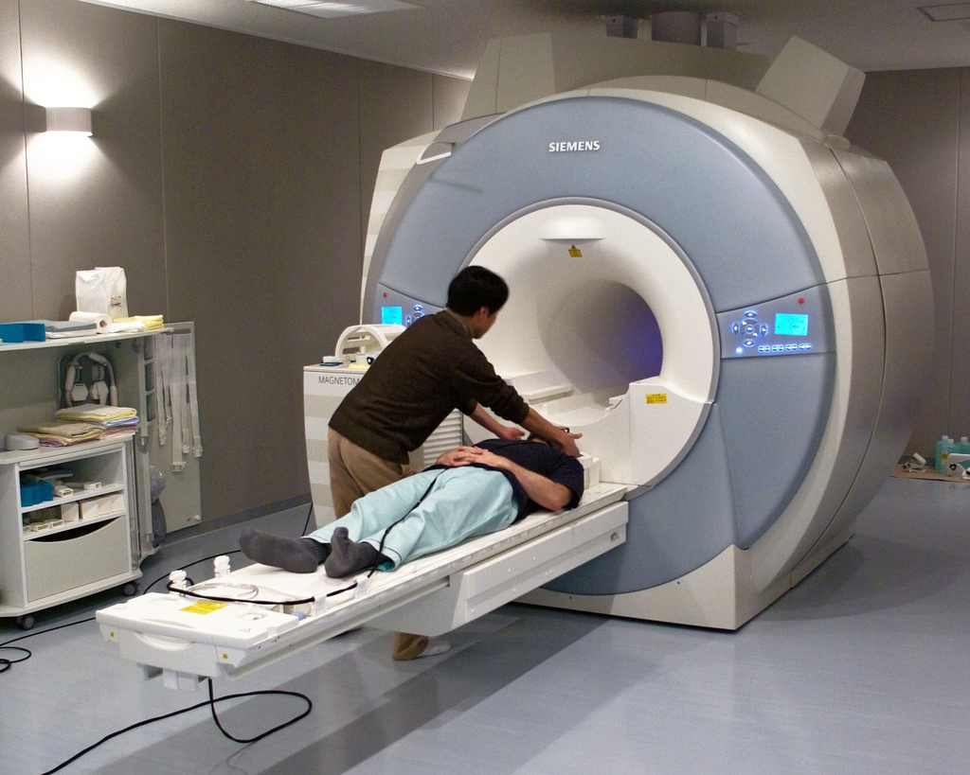
How does this compare to fMRI?
https://www.youtube.com/watch?v=nvB9hAarzw4
https://www.youtube.com/watch?v=Rb_mdzgw-Jc
Notes:
Functional magnetic resonance imaging or functional MRI (fMRI) is a functional neuroimaging procedure using MRI technology that measures brain activity by detecting changes associated with blood flow. This technique relies on the fact that cerebral blood flow and neuronal activation are coupled. (wikipedia.org)
Turn to someone next to you and in your own words explain how fMRI works.

Slide 21
Friday Agenda
Benefits and weaknesses of fMRI
Sample EEG study on the N400
For Monday: Read Kuhl’s “Neural substrates of language acquisition” (available under Course Content > Week 2)
NOTE: please directly write your reading responses, don’t upload (this makes it easier for me to collect and read them w/o needing to download each response)

Slide 22
Brief Review
Discuss in pairs how fMRI works

Slide 23
Basics of fMRI
Blood flow and neural activity are coupled (Cerebral Blood Flow (CBF) = brain metabolism)
When neurons are active, they use up energy and need more oxygen
Blood vessels dilate to increase blood flow to areas with increased neural activity
Magnet reorients the hydrogen nuclei in water molecules to align them in the same direction with the magnetic field
When the nuclei point in the same direction, their summed magnetic signal can be detected by applying a radio frequency magnetic pulse
Degree of oxygenation of blood changes the MR signal
Blood oxygenation differs dependent on the level of neural activity
BOLD imaging = blood oxygenation level dependent imaging
Notes:
More oxygenated blood has a slightly stronger signal
Blood is more oxygenated when neural activity increases (seems paradoxical bc you would think more activity means more oxygen being used up; but there is initially an over=supply of oxygen in anticipation of the use)
http://fmri.ucsd.edu/Research/whatisfmri.html

Slide 24
So why is fMRI so bad at temporal resolution?
Blocked Designs
  present multiple stimuli (e.g., 5) every 5 seconds for a period of 20 seconds, followed by a period of 20 second rest.
Event-related Designs
  Spaced single trial design = present trial every 16 seconds
  Rapid single trial design = jitter time between trials unpredictably, present trials every 2 to 3 seconds
Notes:
Has to do with biology.
“Neural events happen in milliseconds; however, the blood-oxygenation changes that they induce
are spread out over several seconds, thereby severely limiting fMRI’s temporal resolution.”
Has to do with design.
Blocked – highly predictable
ER – need lots of stimuli to average to get rid of noise (similar to ERP), and requires more time in the scanner as a result (maximum 1 hour of active testing)

Slide 25
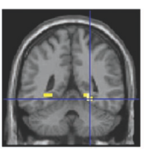
Sample Blocked Design
Encode
Encode
Encode
Encode
Encode
Rest
Rest
Rest
Rest
Rest
Rest
= Encode minus rest

Slide 26
Strengths and Weaknesses: fMRI
The good: spatial resolution (i.e., where)
Also: non-invasive, doesn’t involve radiation
The bad: temporal resolution (i.e., when)
also very expensive $$$ (1million for the system and $500 per session in the scanner)

Slide 27

Brain Imaging: When would you use each?

Slide 28
Journal
So what are the main differences between ERPs and fMRI? What questions are each best poised to answer?

Slide 29
Brain Imaging: What’s the difference?
A good summary: https://theraptorlab.wordpress.com/2013/09/18/top-13-ways-scientists-can-study-your-brain/
Notes:
fMRI - functional Magnetic Resonance
TMS - Transcranial Magnetic Stimulation
EEG - Electroencaphalogram
PET – Positron Emission Tomography
MEG - Magnetoencaphalogram

Slide 30
Kutas & Hillyard (1980)
Reading Senseless Sentences: Brain Potentials Reflect Semantic Incongruity

Slide 31
Background/Purpose
Humans generate expectations

Slide 32
I take my coffee with cream and sugar.
I take my coffee with cream and oil.
I take my coffee with cream and automobiles.

Slide 33
Background/Purpose
Humans generate expectations
What happens in the brain when expectations are violated?
Can the reprocessing of semantically anomalous information be reflected in the neural signature of the brain?

Slide 34
Method
160 different seven-word sentences, 16 experimental blocks of 10 sentences each
Subjects read sentences silently
Sentences presented word by word, one per second.
3 conditions:
  A) correct
  B) moderately inappropriate (25% of stim in Exp 1)
  C) strongly inappropriate (25% of stim in Exp 2)

Slide 35
Demo

Slide 36
XXXXX

Slide 37
HE

Slide 38
SPREAD

Slide 39
THE

Slide 40
WARM

Slide 41
BREAD

Slide 42
WITH

Slide 43
SOCKS

Slide 44
Results
Notes:
Negative component beginning around 250 ms and peaking at about 400 ms. N400 substantially larger after the strong semantic mismatches than the moderate mismatches.
Follow up with physically deviant stimuli (larger print), showed that the effects are not the same.

Slide 45
Conclusion
Semantic deviation reflected in the neural signature of the brain
N400 indexes semantic incongruity as opposed to syntactic or physical differences
Useful tool in evaluating natural language comprehension
Clinical tool in evaluating reading impairment?

Slide 46
Discussion Questions
Does the N400 index other anomalies?
What happens if the semantic anomaly is embedded in a sentence that also violates syntactic properties?

